Slide 1
Rust - Decision Making & Loops
Week 4

Slide 2
How to Read User Input in Rust
Import the std::io crate
Generate a mutable String variable
Generate a variable stdin with an instance of io::stdin()
Trigger the method .read_line() from stdin
Run your code: read the user input

Slide 3
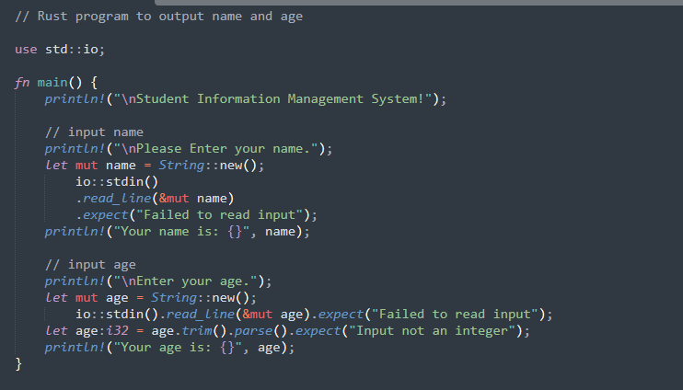
Rust - Standard Input
Practice 1: week-4/practice_1/src/main.rs

Slide 4
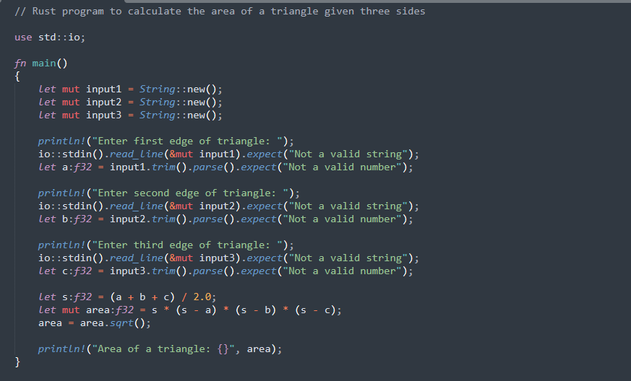
Another Standard Input illustration:
Practice 2: week-4/practice_2/src/main.rs

Slide 5
Rust – Decision Making
Decision-making structures require that the programmer specify one or more conditions to be evaluated or tested by the program, along with a statement or statements to be executed if the condition is determined to be true, and optionally, other statements to be executed if the condition is determined to be false.

Slide 6
Rust – Decision Making
Condition
If condition
is true
If condition
is false
Condition code

Slide 7
Rust – Decision Making
Sr.No | Statement & Description
1 | if statement An if statement consists of a Boolean expression followed by one or more statements.
2 | if...else statement An if statement can be followed by an optional else statement, which executes when the Boolean expression is false.
3 | else...if and nested ifstatement You can use one if or else if statement inside another if or else if statement(s).
4 | match statement A match statement allows a variable to be tested against a list of values.

Slide 8
Rust – If Statement
The if…else construct evaluates a condition before a block of code is executed.
Syntax:
if boolean_expression {
// statement(s) will execute if the boolean expression is true
}
If the Boolean expression evaluates to true, then the block of code inside the if statement will be executed. If the Boolean expression evaluates to false, then the first set of code after the end of the if statement (after the closing curly brace) will be executed.

Slide 9
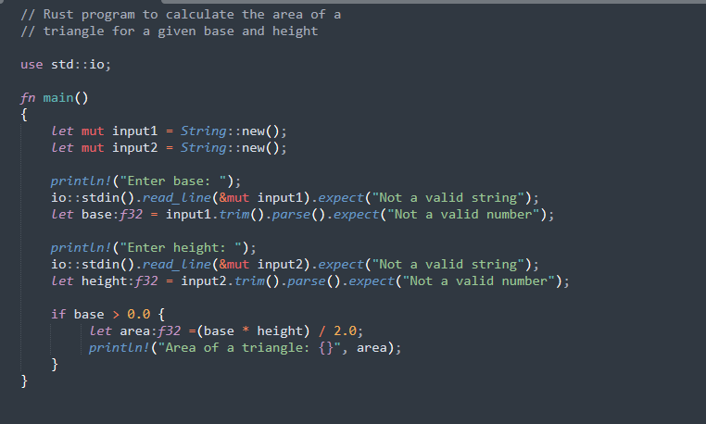
If Statement illustration:
Practice 3: week-4/practice_3/src/main.rs

Slide 10
Rust – If…else Statement
An if can be followed by an optional else block. The else block will execute if the Boolean expression tested by the if statement evaluates to false.
Syntax:
if boolean_expression {
// statement(s) will execute if the boolean expression is true } else {
// statement(s) will execute if the boolean expression is false
}
The if block guards the conditional expression. The block associated with the if statement is executed if the Boolean expression evaluates to true.
The if block may be followed by an optional else statement. The instruction block associated with the else block is executed if the expression evaluates to false.

Slide 11
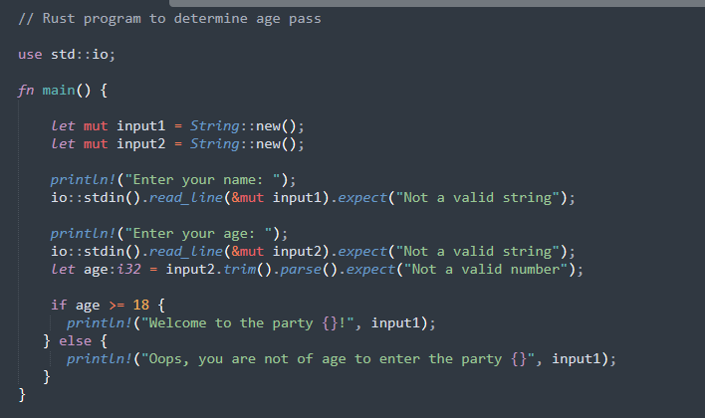
If…else Statement illustration:
Practice 4: week-4/practice_4/src/main.rs

Slide 12
Nested If Statement
The else…if ladder is useful to test multiple conditions.
Syntax:
if boolean_expression1 {
//statements if the expression1 evaluates to true
} else if boolean_expression2 {
//statements if the expression2 evaluates to true
} else {
//statements if both expression1 and expression2 result to false
}
When using if…else…if and else statements, there are a few points to keep in mind.
An if can have zero or one else's and it must come after any else..if.
An if can have zero to many else..if and they must come before the else.
Once an else..if succeeds, none of the remaining else..if or else will be tested.

Slide 13
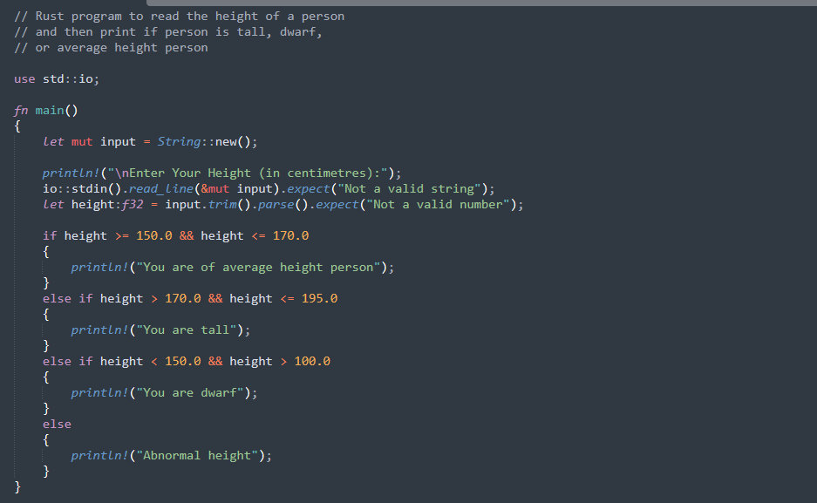
Nested If Statement
Practice 5: week-4/practice_5/src/main.rs

Slide 14
Loops
A loop statement allows us to execute a statement or group of statements multiple times. Programming languages provide various control structures that allow for more complicated execution paths. There may be instances, where a block of code needs to be executed repeatedly. In general, programming instructions are executed sequentially: The first statement in a function is executed first, followed by the second, and so on.

Slide 15
General form of a Loops
Condition code
Condition
If condition
is true
If condition
is false

Slide 16
Types of Loops
Definite Loop
While
Loop
For
Indefinite Loop

Slide 17
Definite Loop
A loop the number of iterations of which is definite/fixed is termed as a definite loop. The for loop is an implementation of a definite loop.
For Loop
The for loop executes the code block for a specified number of times. It can be used to iterate over a fixed set of values, such as an array.
Syntax:
for temp_variable in lower_bound..upper_bound {
//statements
}

Slide 18
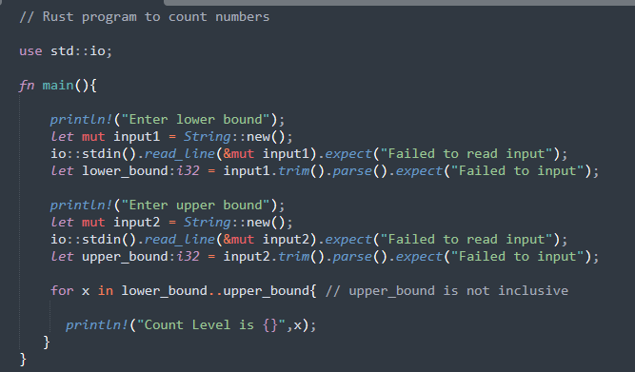
For Loop illustration:
Practice 6: week-4/practice_6/src/main.rs

Slide 19
Indefinite Loop
An indefinite loop is used when the number of iterations in a loop is indeterminate or unknown.
Indefinite loops can be implemented using:
Sr.No | Name & Description
1 | While The while loop executes the instructions each time the condition specified evaluates to true
2 | Loop The loop is a while(true) indefinite loop

Slide 20
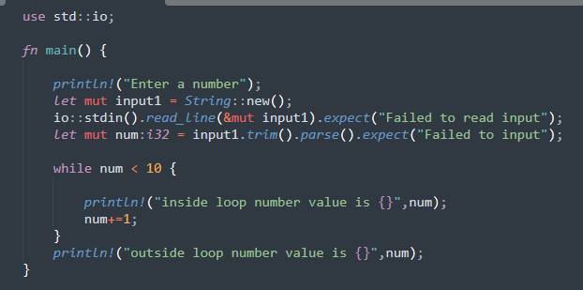
While Loop illustration:
Practice 7: week-4/practice_7/src/main.rs

Slide 21
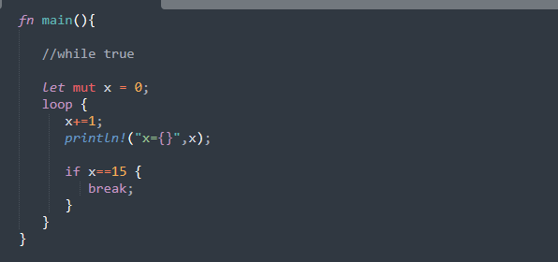
Loop illustration:
Practice 8: week-4/practice_8/src/main.rs
The break statement is used to take the control out of a construct. Using break in a loop causes the program to exit the loop.

Slide 22
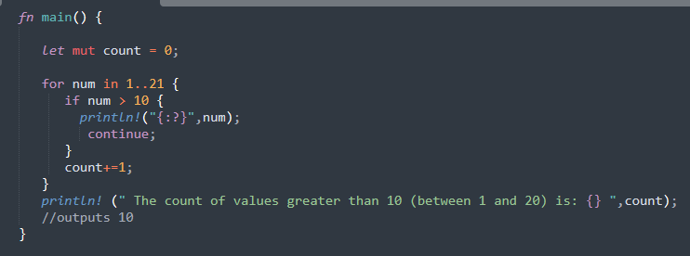
Continue Statement illustration:
The continue statement skips the subsequent statements in the current iteration and takes the control back to the beginning of the loop. Unlike the break statement, the continue does not exit the loop. It terminates the current iteration and starts the subsequent iteration.
Practice 9: week-4/practice_9/src/main.rs

Slide 23
Class Projects

Slide 24
Project I
Given the values of a, b and c, find the roots of a quadratic equation using Rust program.
Hints:
Input the values from the keyboard
Find the discriminant. The discriminant determines the number and nature of the roots.
If the discriminant is positive, then there are two distinct roots.
If the discriminant is zero, then there is exactly one real root.
If the discriminant is negative, then there are no real roots.

Slide 25
Project II
Develop a program in Rust that takes as input the experience and age of an employee to determine the annual incentive, with the following criteria:
If the employee is experienced and his/her age is equal to or more than 40, then the incentive of the employee is N1,560,000.
If the employee is experienced and his/her age is equal to or more than 30 but less than 40, then the incentive should be N1,480,000.
For experienced employee below 28 years of age the incentive should be N1,300,000 per month.
For inexperienced employee the incentive should be N100,000.

